Slide 1

smart_home_systems
Alexandru Georgescu

Slide 2

Problem Statement
Homeowners face numerous challenges in managing temperature control, security, and lighting in their homes.
Inefficiencies of Traditional Systems: Traditional thermostat, doorbell, and lighting systems are often inefficient and inconvenient to manage
We need a Smart Solution: There is a growing demand for a smart home system that integrates these components to provide automation.

Slide 3
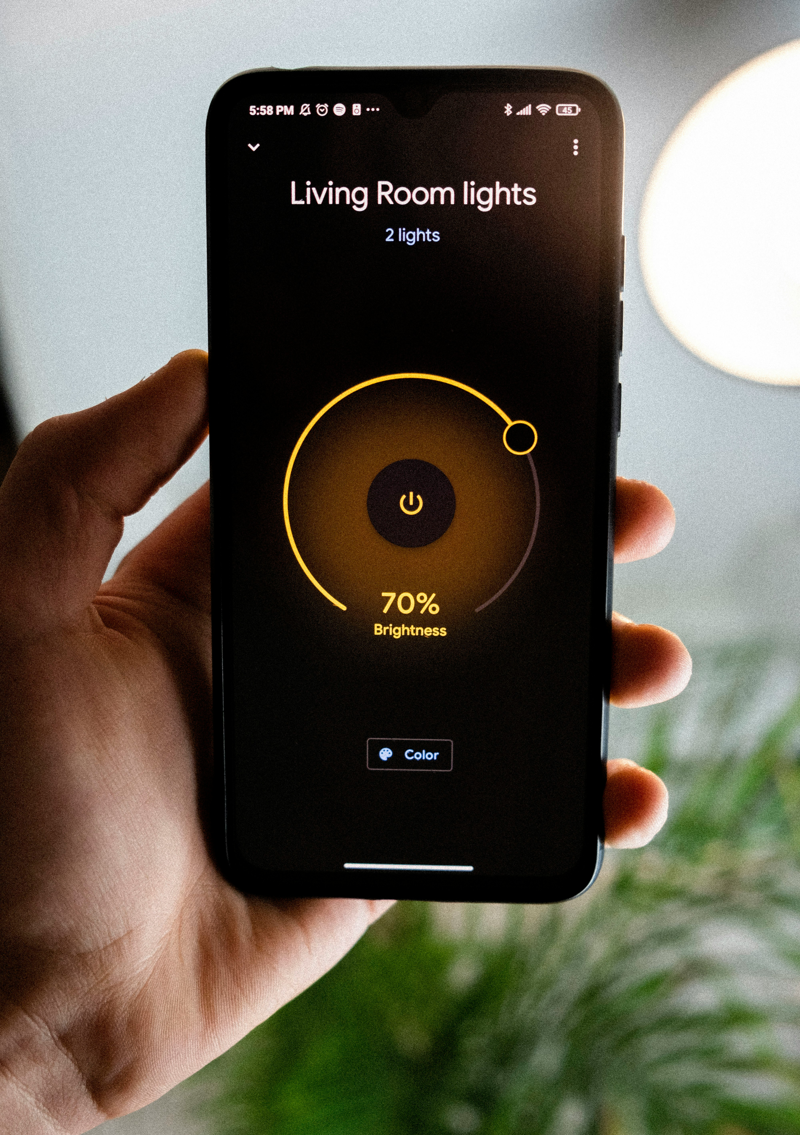
Smart Home
Our solution is a comprehensive Smart Home Management System designed to address the challenges faced by homeowners.
Integration of Smart Devices: Our system integrates smart thermostat, doorbell, and lighting functionalities to provide users with enhanced control and automation
Key features
Remote access: Users can control and monitor their home environment remotely from anywhere
Energy Efficiency: Smart algorithms optimize energy usage, leading to cost saving and environmental benefits

Slide 4
Libraries
GRPC: Used for implementing the communication protocol between clients and services.
Chalk: Utilized for adding coloured text and styling to the command-line interface
ProtoLoader: Used to load Protocol Buffer definitions and generate gRPC client and server code
Inquirer: Implemented for creating interactive command-line prompts and user-input handling

